Slide 1
Lecture 1
Initial Value Problems

Slide 2
Introduction
Equations which are composed of an unknown function and its derivatives are called differential equations
Differential equations play a fundamental role in engineering as almost any model will involve them
Differential equations are classified according to their order:
A first order equation includes a first derivative as its highest derivative.
A second order equation includes a second derivative
Notes:
This last lesson of the semester is about initial value problems
We will learn that solving numerically differential equations and initial value problem is very challenging. Especially the control of the error will be quite tricky. A further difficulty is that the answer of our problem is no longer a number, but a function.
But before diving into this topic, we will review together some concepts you learned in calculus about initial value problems and differential equations.
In calculus you learned that equations which are composed of an unknown function and its derivatives are called differential equations
Differential equations play a fundamental role in engineering as almost any model will involve them
Differential equations are classified according to their order:
A first order equation includes a first derivative as its highest derivative.
A second order equation includes a second derivative

Slide 3
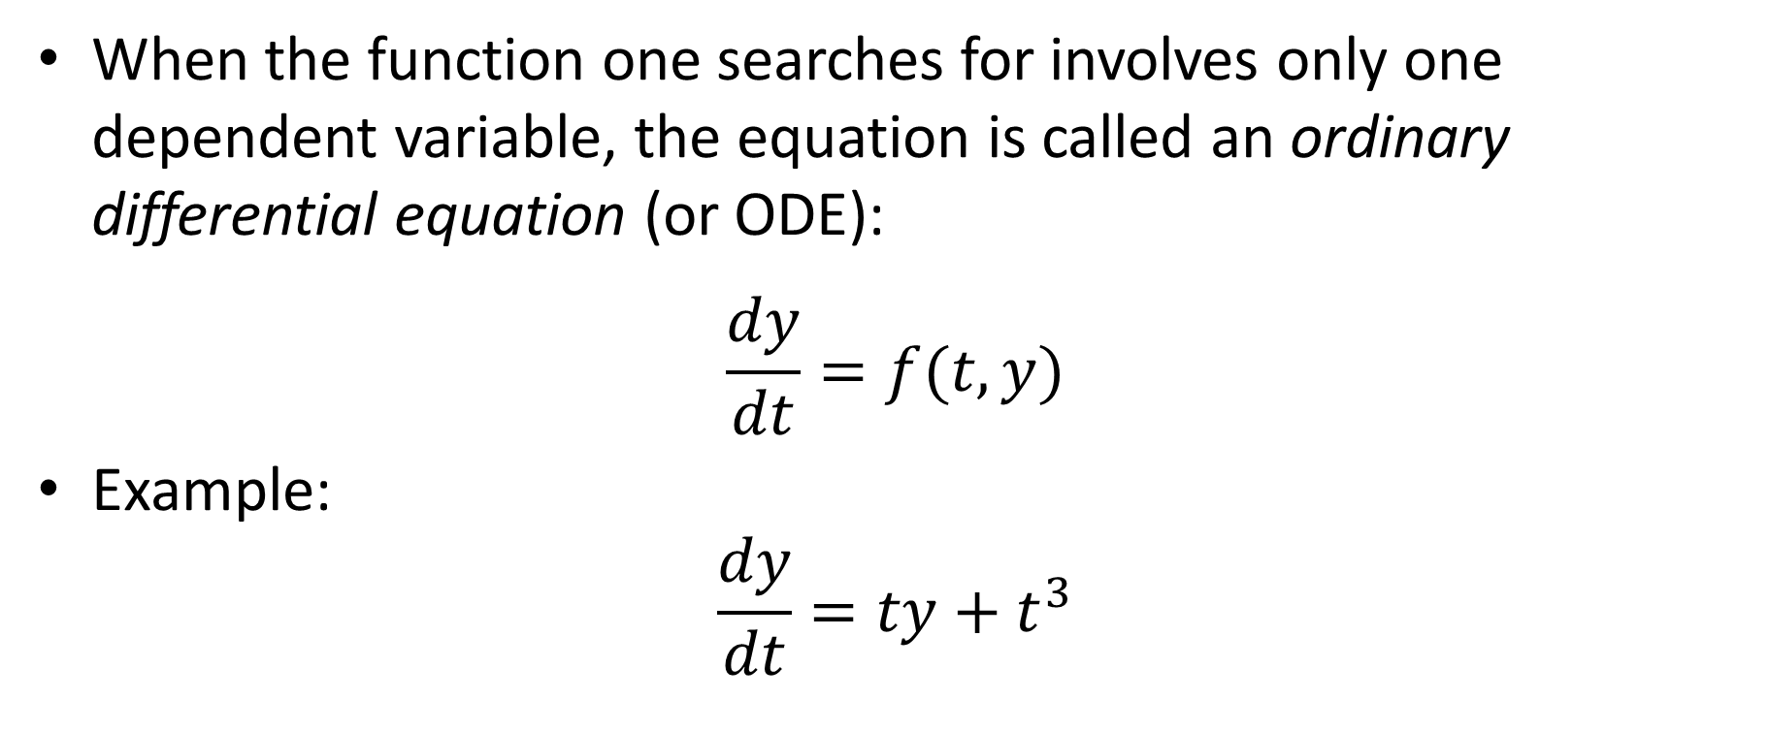

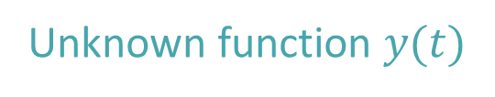
Ordinary Differential Equations
When the function one searches for involves only one dependent variable, the equation is called an ordinary differential equation (or ODE):
$$\frac{dy}{dt}=f(t,y)$$
Example:
$$\frac{dy}{dt}=ty+t^{3}$$
Dependent variable
Unknown function $y(t)$
$f\left(t,y\right)=ty+t^{3}$
Notes:
When the function one searches for involves only one dependent variable, the equation is called an ordinary differential equation (or ODE)
The standard form for first order ODEs is
$$\frac{dy}{dt}=f(t,y)$$
The function we search for is y.
This function depends on one variable, which we write as t.
As the ODE involves only the first derivative of the unknown function, we have indeed a first order differential equation
On the right hand side we have some expression which will depend on the depended variable t and the unknown function y/
We group this expression into the function f in two variables t and y.
Let us give an example:
$$\frac{dy}{dt}=ty+t^{3}$$
Here f(t,y) is equal to $ty+t^{3}$

Slide 4
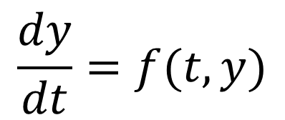



Graphical solutions of ODEs
$$y$$
$$f(t,y)$$
$$\frac{dy}{dt}=f(t,y)$$
$$t$$
Notes:
ODEs are very challenging to solve
However, they have a simple graphical interpretation which allows to find easily graphically a solution
Consider the differential equation $\frac{dy}{dt}=f(t,y)$
We want to find a function y(t) which satisfies this equation.
Consider now the y,t plane and a particular point (t,y) of this plane
The differential equation tells us that the slope of the function y(t) we search is given by computing f(t,y)
This value can be computed and represented by s short segment having the corresponding slope

Slide 5
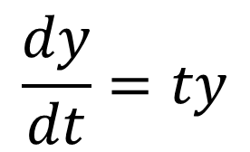



Graphical solutions of ODEs – Slope fields
$$y$$
$$\frac{dy}{dt}=ty$$
$$1$$
$$1$$
$$t$$
Notes:
Let us apply this observation to the equation $\frac{dy}{dt}=ty$
Let us consider the point (1,1) in the (t,y) plane
According the differential equation, the slope of the solution y(t) passing by that point must be equal to 1 times 1, which is one
We add a short segment of slope 1 passing by the point (1,1)
We can repeat this exercise for other points
For example the points (1,2) and (1,3)
For the points (0,1), (0,2), (0,3) etc the slope is always equal to zero according the differential equations
We can go on like this for other points
In the present case we can take advantage of several symmetries to reduce the calculations
Because f(t,y)=ty, the slopes will be symmetric according the t and y axis
The resulting plot is called a slope field
It becomes now quite easy to guess how look the solutions of our differential equation

Slide 6
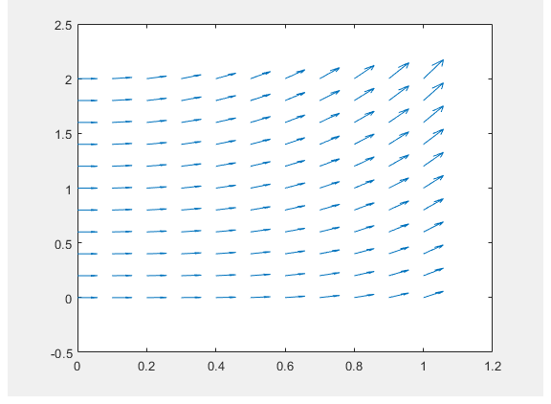

Using Matlab
$$\frac{dy}{dt}=ty+t^{3}$$
>> [t,y] = meshgrid(0:0.1:1,0:0.2:2);
>> u = ones(size(t));
>> v = t.*y+t.^3;
>> quiver(t,y,u,v)
Notes:
Slope fields can be computed by matlab with the command quiver
Let us explain how to use it
First step is to great a mesh of points with the command meshgrid
The first argument is the range for the horizontal axis (the t axis in our case).
The second argument is the range for the vertical axis (the y axis in our case).
For each range one can chose the spacing between the various points.
In our case we did chose to compute a grid going from 0 to 1m with a step of 0.1 for the t axis
As for the y axis we want points between 0 and 2 spaced by 0.2
The function returns two arguments which serve to store the computed grid in form of two vectors
Next we compute the small segments we want to have in the slope field
These segments are vectors with two components
For the first component, which is the horizontal component, we choose them equal to one.
This is stored into the vector u which has the same size as the vector t.
For the second component, the vertical one, we compute it to be equal to f(t,y).
t being a vector it requires the specific syntax to manipulate the vector component by component.
For example t.*y tells matlab to multiply each component of t by the corresponding component of y
The result is stored into the vector v
We have now for vectors.
The vectors t and y which give the coordinates of the points in the (t,y) plane for which we want to plot the slop field
The vectors u and v are the small segments having the slopes we want to display in the slope field
To plot the slopes, we now use the command quivert
The first two arguments are the coordinates of the grid and the second arguments are the components of the vectors to be plotted in each grid point
The result is the plot of the slope field
Again, it becomes easy to imagine how will look the solutions to the differential equation

Slide 7

Initial Value Problems
First order initial value problem (IVP)
$$\left\{\begin{aligned}\frac{dy}{dt}=f(t,y) \\ y\left(t_{o}\right)=y_{o} \\ t∈\left[t_{o},t_{f}\right]\end{aligned}\right.$$
Initial condition
Notes:
As you know from calculus, and as well realized when plotting slope fields, a differential equation does not have a single solution, but rather a family of solutions
Numerically this is not a pleasant situation.
This why one does not attempt to solve differential equation but rather initial value problems
Initial value problems select a specific solution among the family of solutions from the differential equation
This is achieved by adding an initial condition in the form of $y\left(t_{o}\right)=y_{o}$.
This conditions selects the solution passing by the point $t_{o}$, $y_{o}$
Usually one adds a third condition that one searches for the solution between $t_{o}$ and $t_{f}$
In future we will often use the acronym IVP to refer to initial value problems

Slide 8
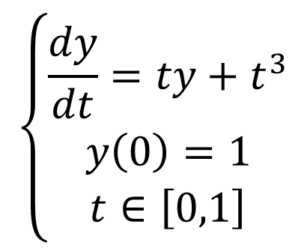
Example
$$\left\{\begin{aligned}\frac{dy}{dt}=ty+t^{3} \\ y\left(0\right)=1 \\ t∈\left[0,1\right]\end{aligned}\right.$$
Notes:
If we go back to our example, we can add the initial condition y(0)=1
We know already the slope field
We select now the solution passing by the point (0.1)
The solution is of course a qualitative solution, but still gives an excellent idea about how looks the actual solution

Slide 9
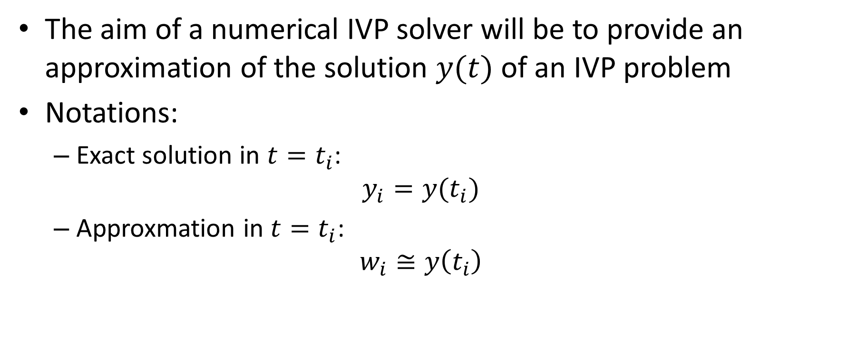
Numerical IVP Solver
The aim of a numerical IVP solver will be to provide an approximation of the solution $y(t)$ of an IVP problem
Notations:
Exact solution in ${t=t}_{i}$:
$${y_{i}=y(t}_{i})$$
Approxmation in ${t=t}_{i}$:
$$w_{i}≅y\left(t_{i}\right)$$
Notes:
Now we know how to get some graphical solutions of ODEs let us discuss how we solve numerically initial value problems
Algorithms that solve numerically IVPs are called IPV solvers
The aim of a numerical IVP solver is to provide an approximation of the solution $y(t)$ of an IVP problem
Let us introduce two important notations
First for the exact solution.
The exact solution in some point ${t=t}_{i}$ will be referred to as $y_{i}$
Second for the approximation produced by the IVP solver
The approximation of the exact solution in some point ${t=t}_{i}$ will be referred to as $w_{i}$

Slide 10
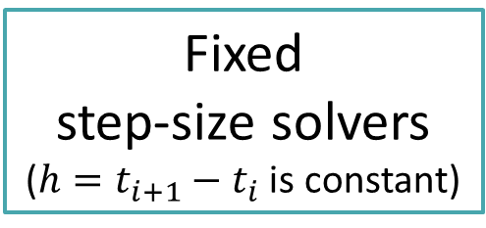
Overview of IVP solvers
IVP Solvers
Fixed step-size solvers
(${h=t}_{i+1}−t_{i}$ is constant)
Variable step-size solvers
Notes:
In the semester we will discuss tow families of IVP solvers
The first one are the so-called fixed step-size solvers
These algorithms produce approximations $w_{i}$ at equally spaced points $t_{i}$
The distance between two of these points is referred to as the step-size h.
The second family are variable step-size solvers
These algorithms produce approximations $w_{i}$ at points $t_{i}$ which are not equally spaced
In fact, these algorithms will adapt the step-size as the calculations progress in order to maintain the error, the difference between the exact solution and approximation, below a fixed threshold

Slide 11
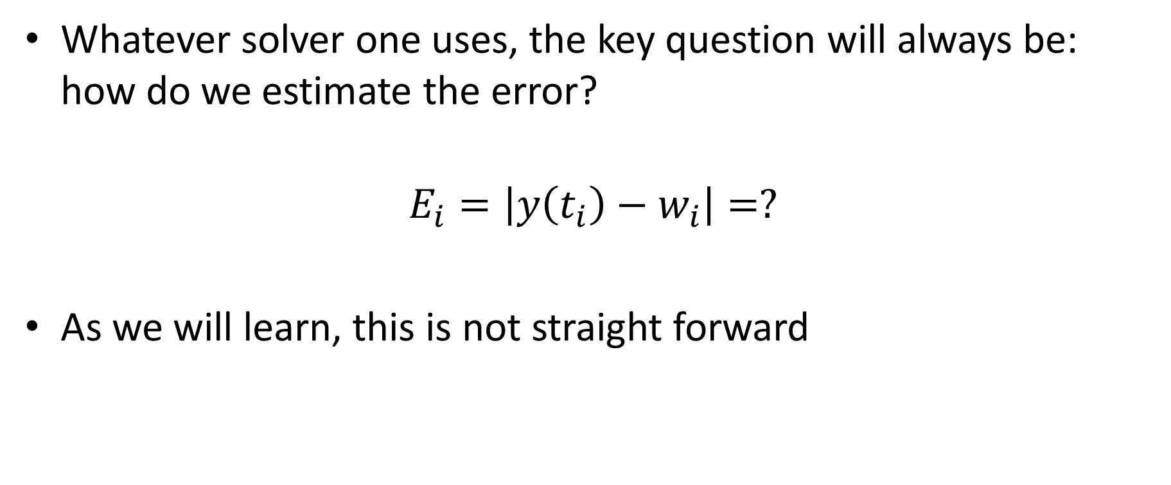
Error estimations
Whatever solver one uses, the key question will always be: how do we estimate the error?
$$E_{i}=\left|y\left(t_{i}\right)−w_{i}\right|=?$$
As we will learn, this is not straight forward
Notes:
But regardless on which solver one uses, the key question will always be: how do we estimate the error.
The error is defined in each point ti where the solver provides an approximation as $E_{i}=\left|y\left(t_{i}\right)−w_{i}\right|$
As we will learn, this task is not straight forward

Slide 12
Summary
Ordinary differential equations have a family of solutions
Slop-fields allow to visualize this family
Initial value problems select a particular solution of this family by adding an initial condition
Algorithms solving initial value problems are called IVP solvers
One of the key challenge will be to learn how to estimate the error of the approximation produced by IVP solvers
Notes:
Let us summarize the key findings
Ordinary differential equations have a family of solutions
Slop-fields allow to visualize this family
Initial value problems select a particular solution of this family by adding an initial condition
Algorithms solving initial value problems are called IVP solvers
One of the key challenge will be to learn how to estimate the error of the approximation produced by IVP solvers

